Slide 1

Machine Learning March Madness
Noah Roberts | May 5th, 2025
Source Code

Slide 2
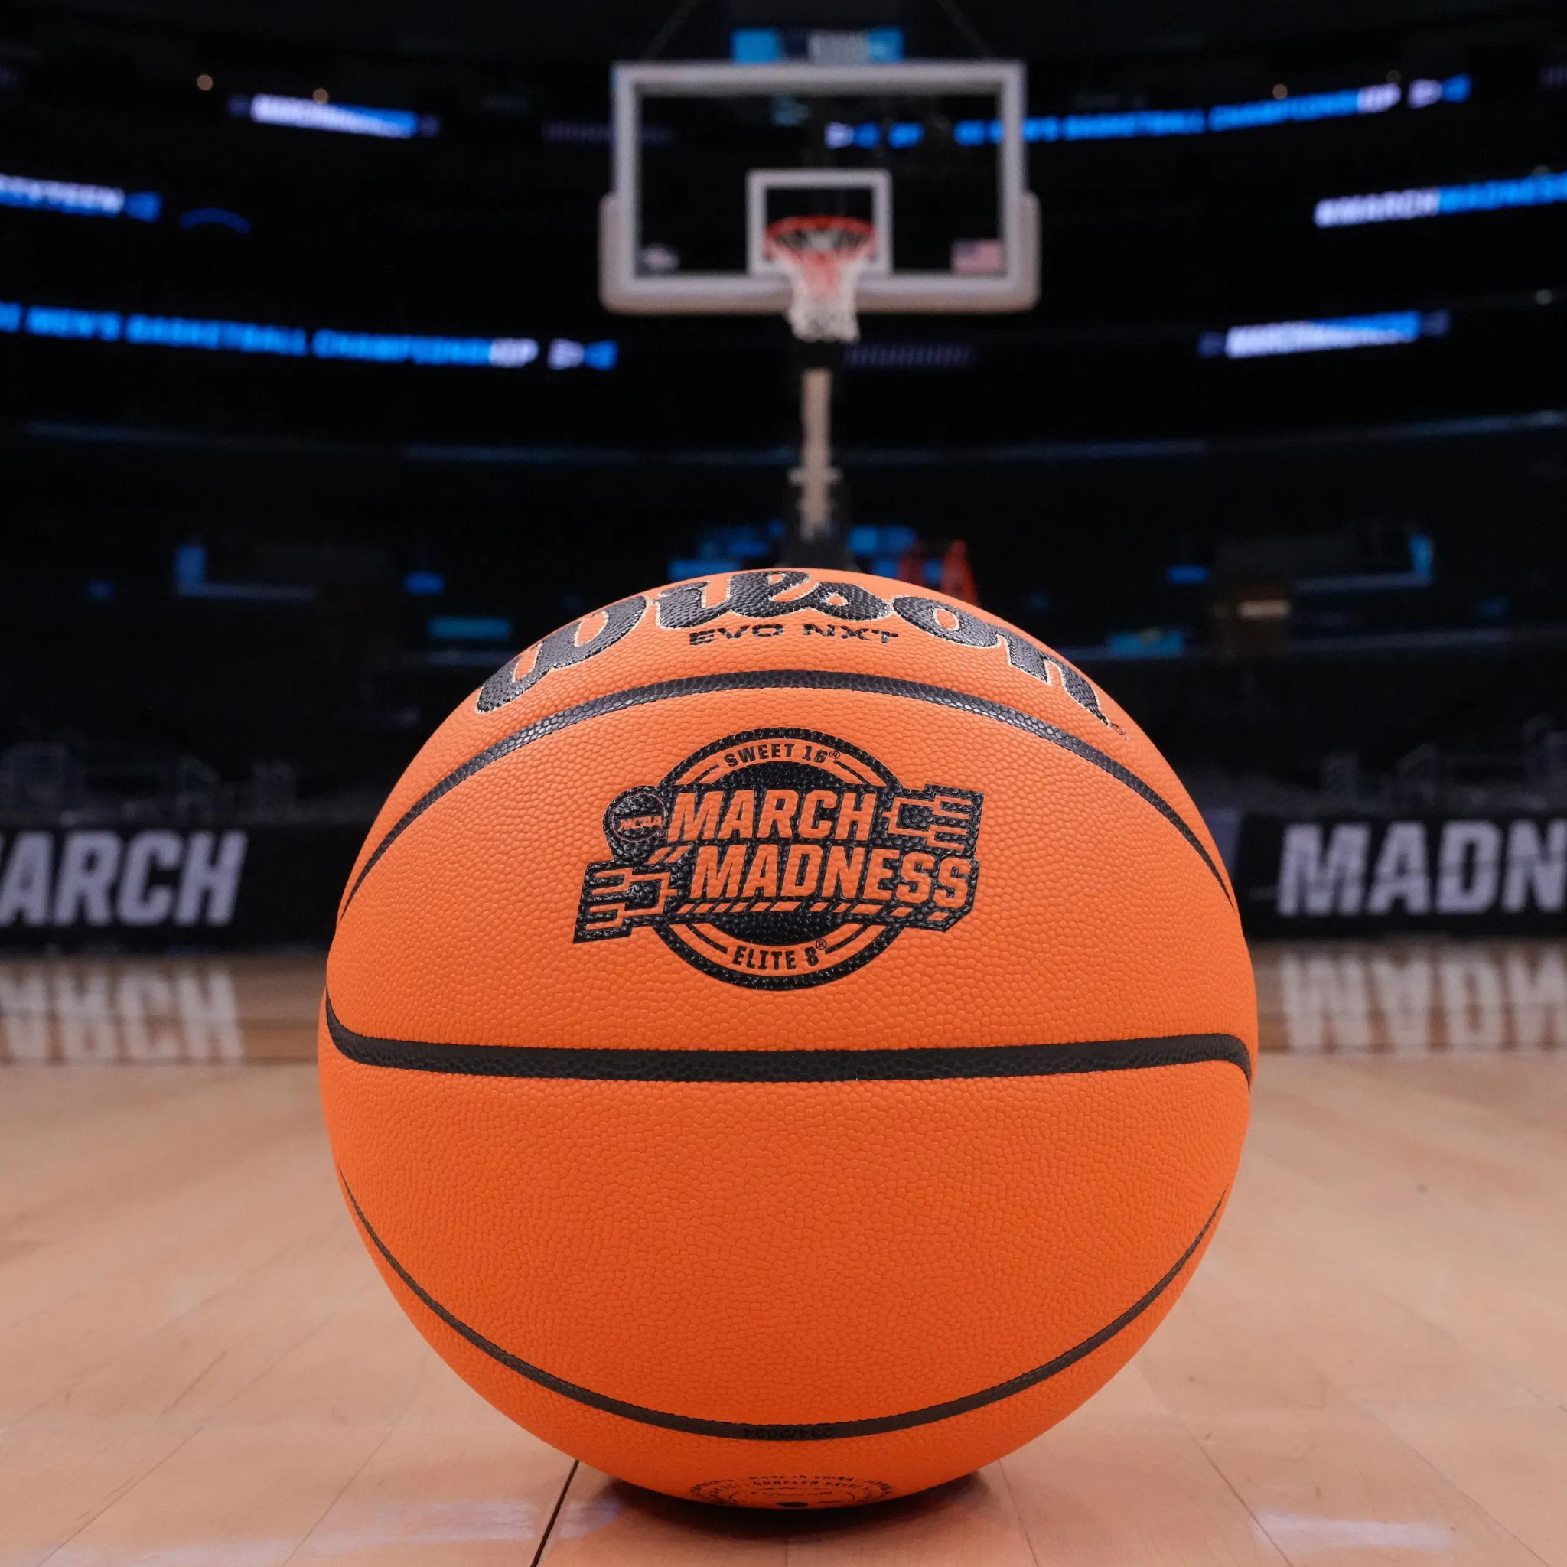
Machine Learning March Madness
Background & Motivation
The NCAA March Madness tournament is notoriously difficult to predict due to its frequent upsets and randomness
Traditional bracket prediction methods rely on public rankings, conference strength, and gut feeling
Our method aims to take a data-driven approach using statistical features
This allows an exploration of how seeding, efficiency, and advanced metrics correlate with actual tournament outcomes

Slide 3

Machine Learning March Madness
Datasets
Collected NCAA tournament matchups and team-level season stats from 2012-2025 (excluding 2020)
Matchup data scraped from Sports Reference using BeautifulSoup
Each row represents a single tournament game
63 games per. tournament x 13 years = 819 tournament matchups
Stats include regular-season performance for each tournament team
Each row represents a
64 teams x 13 years = 832 tournament teams

Slide 4
Machine Learning March Madness
Features
Each pair of team’s statistics were collected for each matchup:
Shooting stats (FG%, 3P%, FT%)
Rebounds (Off, Def, Total)
Turnovers, assists, blocks, steals, fouls
Seeding
Advanced metrics:
Shooting Efficiency
Strength of Schedule
Simple Rating System
Each team’s opponents stats were also collected for each of the above features
Expected output is a binary classification:
0 if team_a wins
1 if team_b wins

Slide 5
Machine Learning March Madness
Intuition
We hypothesize that the difference in team statistics correlates strongly with game outcomes
Instead of using the raw collected stats, we used statistical deltas between two teams to capture the advantage one team may have over the other
Each matchup is encoded as team_a_stats - team_b_stats

Slide 6
Machine Learning March Madness
Data Processing
During preliminary testing, our model showed suspiciously high accuracy in both prediction metrics and tournament simulations
Upon investigation, we found that our original dataset, scraped from season summary pages, included tournament games
This introduced data leakage: teams that made deep runs had inflated stats (e.g., more rebounds, points), which biased the model to favor teams with simply more games played
As a result, the model learned that “higher stats = winner”, rather than identifying meaningful patterns
To fix this, we rewrote the scraper to only aggregate regular season statistics and normalize them per game, ensuring a fairer and more generalizable training set

Slide 7
Machine Learning March Madness
Model Architecture & Algorithms
We framed our task as a binary classification problem: given two teams and their regular season-stats, predict the winner
Our primary model is Logistic Regression due to its interpretability (win%) and solid baseline performance
We also tested additional models for comparison:
Support Vector Machine (SVM)
Random Forest
K-Nearest Neighbors (KNN)
Naive Bayes

Slide 8
Machine Learning March Madness
Training Setup
For each tournament year, we used a leave-one-year-out evaluation strategy:
One tournament year (e.g., 2023) was held out for testing
All other years were used for training data
Features were normalized using scikit-learn StandardScaler to eliminate the mean and scale to unit variance
We used balanced class weighting since the lower seeds win more often
Hyperparameters:
C: 1.0
Epochs: 1000
Given the small dataset, our model was trained on local CPU

Slide 9
Machine Learning March Madness
Experimental Results
Due to tournament variance, the performance of each model varied heavily year-to-year
To our surprise, Random Forest performed the best across all tournaments
 | Logistic Regression | SVM | Random Forest | KNN | Naive Bayes
Avg. Accuracy % | 70.6% | 70.0% | 73.0% | 66.6% | 68.4%
Min Accuracy % | 60.3% (2022) | 60.3% (2022) | 66.7% (2016) | 61.9% (2019) | 60.3% (2021)
Max Accuracy % | 82.5% (2019) | 82.5% (2019) | 81.0% (2025) | 73.0% (2023) | 84.1% (2025)

Slide 10
Machine Learning March Madness
Results Insights
Logistic Regression and SVM performed similarly and had the most consistent results
All models performed significantly worse for the 2022 tournament which suggests more unpredictability that year
The 2025 tournament was a notoriously predictable year (all four #1 seeds reached FInal 4)
Naive Bayes achieved the highest accuracy this year, which makes sense since it thrives on consistent, linearly separable data
In contrast, it performed worse in more chaotic years where its simplistic assumptions break down
What is most interesting is KNN performed the worst in 2019 whereas Logistic Regression and SVM performed their best that year

Slide 11
Machine Learning March Madness
Tournament Simulation
While predicting individual matchups is a good baseline, the motivation for this project is to predict the entire bracket
Using our trained Logistic Regression model, we simulated the full NCAA Tournament bracket
While we didn’t achieve a perfect bracket, Final Four and National Champion predictions were usually accurate and aligned with top-seeded teams, suggesting realistic forecasting
Common upsets (eg., 12-seed beating 5-seed) were occasionally predicted, mirroring real-world tournament behavior

Slide 12
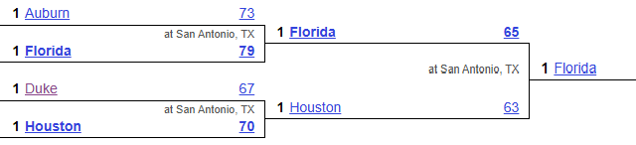
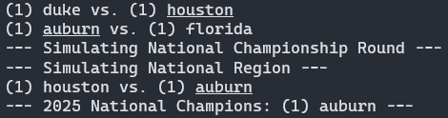
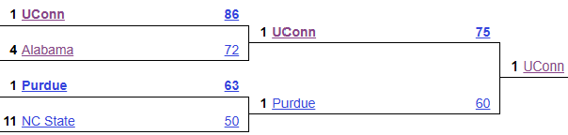
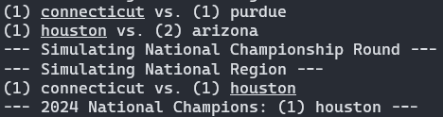
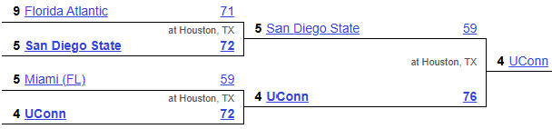
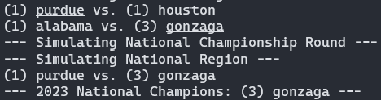
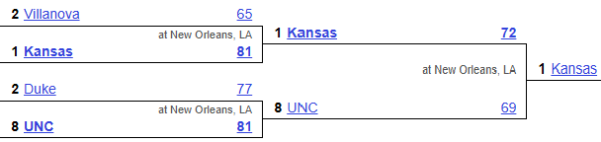
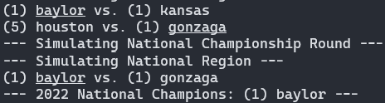
Machine Learning March Madness
Tournament Simulation Results
Actual
Predicted
2025
2024
2023
2022

Slide 13
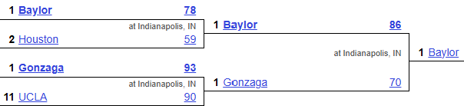
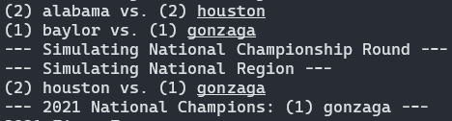
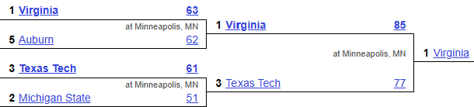
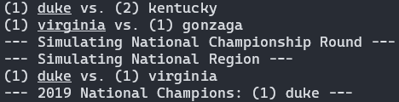
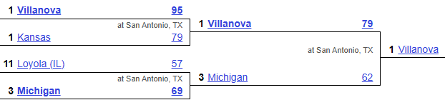
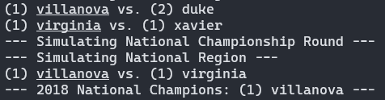
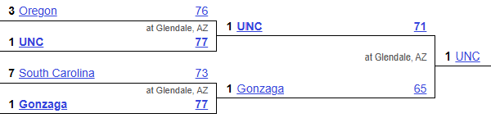
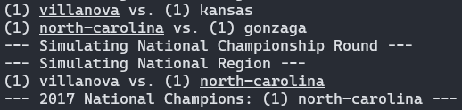
Machine Learning March Madness
Tournament Simulation Results
Actual
Predicted
2021
2019
2018
2017

Slide 14
Machine Learning March Madness
Related Work
Andrew D. Kvam and Steven L. Sokol. March Madness prediction: Different machine learning approaches. Managerial and Decision Economics, 2021. DOI: 10.1002/mde.3814.
Included tournament games from 2006-2017
Determined that neural networks outperformed all other classifiers
Used non-box score statistics including: (distance traveled, attendance, program history, etc)
Jared Forsyth, Andrew Wilde A Machine Learning Approach to March Madness. Brigham Young University, CS 478 Machine Learning, 2014. axon.cs.byu.edu
Used different models, feature selection techniques, and ordering to achieve the highest prediction accuracy
Determined that random ordering with KNN and Random Forest produced the best results
Used ESPN for dataset
Started with 94 features initially

